Slide 1
A Survey of
Hidden Markov Models and Their Applications in Multimodal Data Fusion
— The First Part of the Second Examination
Weihong Li
Advisor: Prof. Zhigang Zhu
Committees:
Prof. Robert Haralick
Prof. Esther Levin
Prof. George Wolberg
Dr. Michael Chan
Notes:
Today, I will be talking about A survey of …., which is my first part of the second exam.
My name is Weihong, and my advisor prof zhu is sitting here.
Prof. Haralick, Prof. Levin, Prof. Wolberg.
We are using tele-conference phone and Dr. chan is at the other side of the phone.
Of course, here is Prof. Ted Brown, our EO, Executive Officer.
Here multimodal data fusion means fuse or integrate data from multiple sensors, like data from mic, which is audio, data from camera, which is video, text, seismic data, and data from other sources.

Slide 2
Outline
Introduction
Hidden Markov Models
Extensions of Hidden Markov Models
HMMs in Unimodal Applications
HMMs in Multimodal Applications
Conclusions and Future Research Directions
Bibliography
Notes:
This is the outline of my talk.
First, I will give a brief introduction.
Then, I will talk about the Hidden markov models and their extensions.
After that, we are going to exam the applications based on HMMs, including unimodal and multimodal applications.
Here multimodal data fusion means fuse or integrate data from multiple sensors, e.g., data from mic, which is audio, data from camera, which is video, and data from other sources, like text, seismic data, etc.
Finally, I will conclude my talk and point out some future research directions related to HMMs and Multimodal data fusion.

Slide 3
Outline
Introduction
Hidden Markov Models
Extensions of Hidden Markov Models
HMMs in Unimodal Applications
HMMs in Multimodal Applications
Conclusions and Future Research Directions
Bibliography
Notes:
*** There are a couple of potential projects which I gonna to work on.
*** Most probably, I will work on a surveillance project, and focus on data fusion problem. the scenario is like this:
We have EO/IR camera monitor a place of interest, the system will recognize human being and track the people in the FOV. Also, the system will point Microphone to the tracked people to obtain voice signal. If someone’s talking, the system will try to fuse data from both Mic. which is audio, and data from camera, which is video, and fit the fused data to a 3D talking face to better understand the audio. Also, we could use some other sensors for surveillance.
*** Another possible project is content-based multimedia information retrieval (but too general).
YOU WILL KNOW THE ANSWER DURING MY 2ND PART EXAM, WHICH IS DISSERTATION PROPOSAL.
*** I did not do any serious HMM-based project yet. Therefore, I cannot answer your question. But I think I can answer this question during my dissertation defense.
*** Some thoughts about potential projects:
Point the laser to somewhere.
Use EO/IR to track (daytime/night)
Use uni-directional mic. To fuse two voice signals.

Slide 4
Introduction
Hidden Markov models (HMMs) were initially introduced in the late 1960s and early 1970s.
Many variations and enhancements have been proposed recently.
Most widely used statistical models for sequential data pattern recognition:
  Speech Recognition
  Computational Biology
  Communications
  Handwriting and Text Recognition
  Image Processing and Computer Vision
  Other Applications
The mathematical structures of HMMs are very rich and work very well for some important applications, such as, speech recognition
Notes:
HMMs ….. Late 60s and early 70s, and in the late 80s, Dr. Rabiner gave a very good tutorial on HMMs and their applications in speech recognition.
However, many new variations and enhancements on HMMs have been proposed recently. For example Factorial HMMs enhance standard HMMs by introducing distributed hidden states. Hierarchical HMMs allow multi-scale applications, and coupled HMMs are used for multimedia data fusion.
HMMs are most widely ……., the applications areas include speech, …,,.
The reason why HMMs are so popular is because the mathematical ….

Slide 5
Outline
Introduction
Hidden Markov Models
Extensions of Hidden Markov Models
HMMs in Unimodal Applications
HMMs in Multimodal Applications
Conclusions and Future Research Directions
Bibliography
Notes:
Let’s quickly go through some concepts and principles and also basic problems associated wtih Hidden Markov models.

Slide 6
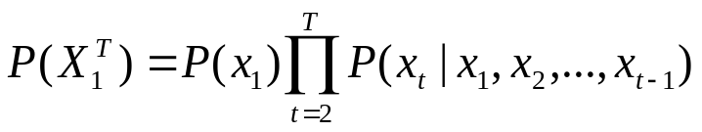
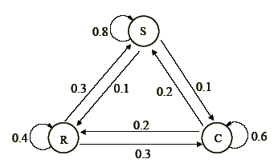
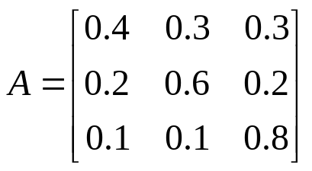
Markov Chain Models
The joint probability distribution of a sequence of observations X₁^{T}={x₁, x₂, ... , x_{T},} can always be factored as
This would be intractable if x_{t} depends on all history (x_{1,} x_{2, … ,}x_{t-1} ).
Assumption of Markov chain: the current observation is determined only by its previous one.
Markov Model consists of
Model states (R, C, S)
Transit probabilities matrix A
Current and predecessor states
Notes:
First, let’s take a look at Markov Model, from which the HMMs are derived.
We know that the joint … as the product of the probability of each observation given all its history.
… This would be intractable if. …., So we need to put some constrains on this.
The assumption on the observation sequence by Markov chain is: the current observation is….
The Markov model based on Markov chain consists of 3 comp. Namely, ……
Let’s take a look at an classical weather example for Markov model
This model consists of 3 states, namely Rain, Cloudy, and Sunny
Transit probability matrix A determine the probability of transiting from one state to another.
from the figure, we can see that output of the model at a particular time t corresponds to the state, which the model is in at this moment. This is too restricted in most real applications, which the output of the system is not only determined by the states.Therefore, HMMs were proposed to model these problems.

Slide 7
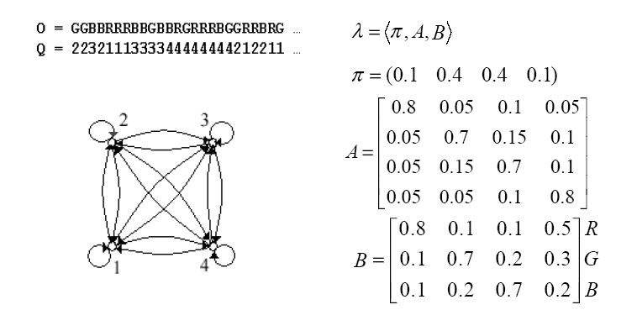



Hidden Markov Models
Doubly embedded stochastic processes.
The formal definition of HMMs:
  The number of states in the model, N .
  The number of observation symbols per state, M.
  The state-transition probability distribution A = {a_{ij}} where
  The observation symbol probability distribution, B = {b_{j}(k)},
  The initial state distribution π = { π_{i} }
Notes:
HMMs are doubly embedded stochastic processes, namely the output of the system is not determined by the state; instead, it can only be observed by another set of stochastic processes that produce the sequence of observation
The process of generating the observation sequence is the following:
1) According to the initial state distribution π, choose an initial state q₁=S_{i}
2) Set t = 1
3) According to the symbol probability distribution in state S_{i}, i.e., b_{i}(k), choose O_{t}=v_{k}
4) According to the state transition probability distribution for state S_{i}, i.e., a_{ij}, transit to a new state q_{t+1}=S_{j}.
5) Set t = t+1; return to step 3) if t<T; otherwise terminate the procedure.
Therefore, the HMMs are specified by Pi, A, B

Slide 8
Three Basic Problems for HMMs
Problem 1 (The Evaluation Problem)
  Given the observation sequence O = O₁O₂…O_{T}, and a model λ, how do we efficiently compute P(O|λ) , namely the probability of the observation sequence, given the model λ= (π, A, B).
Problem 2 (The Decoding or Recognition Problem)
  Given the observation sequence O = O₁O₂…O_{T}, and the model λ, how do we choose a corresponding state sequence Q = q₁q₂…q_{T} , which is optimal in some meaningful sense.
Problem 3 (The Learning Problem)
  How do we estimate the model parameters λ= (π, A, B) to maximize P(O|λ).
Notes:
Given the hidden Markov models, there are three basic problems associated with them.
…
In order to make this survey a little bit more self contained, I will quickly go through the classical algorithms, which were proposed to solve these basic problems.

Slide 9


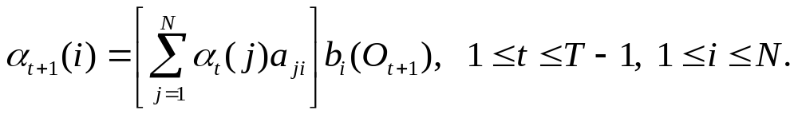
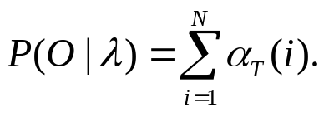
The Evaluation Problem
Given observation O and model λ , compute P(O|λ)
Let be the probability of observing the partial observation sequence, O₁, O₂, . . . ,O_{t}, and in state i at time t, given the model λ
Then, the forward algorithm is as follows:
Initialization:
Recursion:
Termination:
O_{t}
O_{t+1}
O_{t}
O_{t+1}
1
a₁₂
1
1
a₂₁
1
a₂₂
α_{t+1}
β_{t}
a₂₂
2
α_{t}
2
2
2
β_{t+1}
a_{N2}
a_{2N}
N
(a)
N
N
(b)
N
Notes:
First, let’s take a look at the evaluation problem. Namely, given…..,
The Forward-Backward algorithm was proposed to conquer this problem.
Basically, the forward and backward algorithms are based on recursion and make use of dynamic programming technique. So we need to define a variable Alpha for recursion.
Depict the forward algorithm
Depict the backward alg.

Slide 10
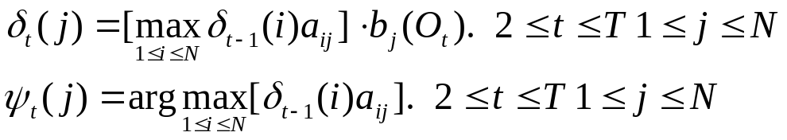
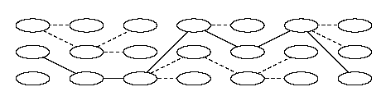
The Recognition Problem
Given observation O and modelλ, find the state sequence, which is optimal.
The Viterbi Algorithm was proposed to conquer this problem.
Let
be the highest probability of state sequences of the length t that end in state i and produce the t first observations for the given model
The recursive part of the Viterbi algorithm can be stated as follows:
Recursion:
Notes:
The Viterbi algorithm chooses one best state sequence that maximizes the likelihood of the state sequence for the whole given observation sequence
The time complexity is O(N²T) for both viterbi and an iteration in EM
Another one is to choose states that are individually most likely at the time when a symbol is emitted. This approach is called posterior decoding.

Slide 11



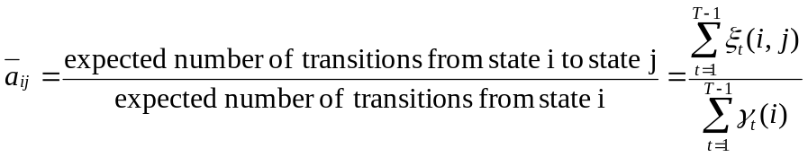
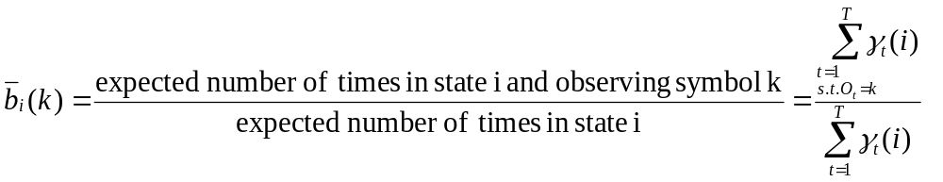
The Learning Problem
Estimate the model parameters λ= (π, A, B) to maximize P(O|λ).
Let be the probability of being in state i at time t and state j at time t+1
An iterated algorithm until converges at local maximum (Baum-Welch/EM )
Calculate:
Re-estimate:
O_{t-1}
O_{t}
O_{t+1}
O_{t+2}
1
a₁₂
1
1
a₂₁
1
a₂₂
α_{t} (2)
β_{t+1} (2)
a₂₂
2
2
2
a₂₂ e₂ (O_{t+1})
2
a_{N2}
a_{2N}
N
N
N
N
Notes:
The most difficult problem is the training problem. Actually, the efficiency of this training procedure provided by the Baum-Welch or EM algorithm makes HMMs very attractive for applications of time-series modeling and classification.
Forward-backward analysis provides the expected values for state given the observations and model parameters; re-estimate adjusts the parameters to maximize model likelihood given the state probabilities and the observation. Together, they form an expectation–maximization procedure that , when repeated until convergence, finds HMM parameters corresponding to a local maximum.
Please note that the equations perform both the expectation step and the maximization step simultaneously. The algorithm proceeds by using the newly derived parameters as the guess for the next iteration.
Refer to the CHMM paper for re-estimate problem.

Slide 12
Outline
Introduction
Hidden Markov Models
Extensions of Hidden Markov Models
HMMs in Unimodal Applications
HMMs in Multimodal Applications
Conclusions and Future Research Directions
Bibliography
Notes:
Now, let us took a look at some extensions of HMMs, which could be useful in terms of data fusion. Because we have only limit time, I am gonna to ignore the training algorithms of these extensions, which are time consuming. And only introduce their particular structures, or framework.

Slide 13
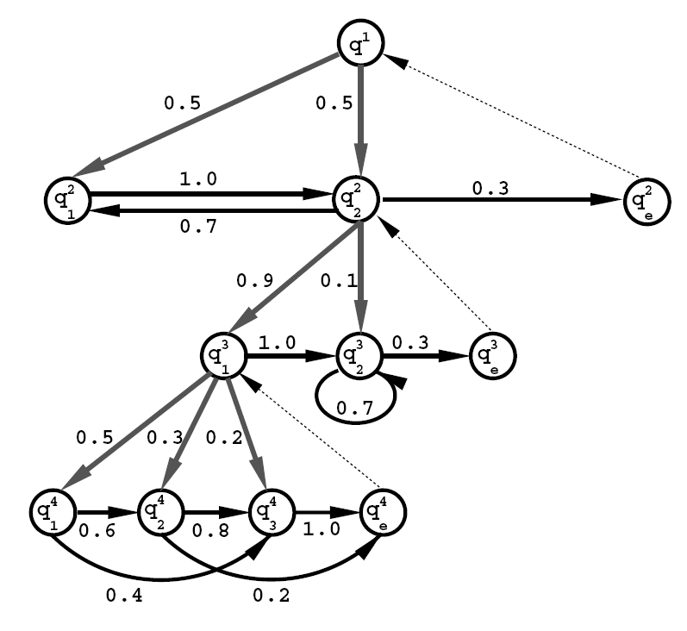
Hierarchical HMMs
HHMMs are structured multi-level stochastic processes.
Each state is also an HHMM.
Production states are the leaves in the tree-like structure and the only states which emit output symbols. Other states are internal states.
Vertical transition is the activa-tion of a substate by an internal state and horizontal transition is a state transition with the same level.
The states of an HHMM emit sequences rather than a single symbol by a recursive activation of one of the substates.
The complexity is O (NT²) for each iteration of EM.
Notes:
… multilevel stochastic processes, The good things about multi-level structure are:
First it enables better modeling of the different stochastic levels and length scales that are present in the natural language, like speech, handwriting, or text. Another good thing is the ability to infer correlated observations over long periods in the observation sequence via the higher levels of the hierarchy. We will see an example of HHMM later on in the application of speech recognition.
Gray and black edges denote the vertical and horizontal transition respectively with corresponding probability associated with the edges. And the dashed thin edges denote returns from the end of each level to the parent state of the level, which initializes the state transition. Eventually, the transition stops at the root state.
The complexity for generalized Viterbi algorithm and Baum-Welch is O(NT²) by using approximation (heuristic )method.
A string is generated by starting from the root state and choosing one of the root’s substates according to initial probability vector. Similarly, for each internal state, one of its substates is randomly chosen according to its initial probability vector. These recursive operations are carried out until a production state is reached, then a single symbol is generated according to the state output probability vector. Then, it chooses the next state in the same level according to the level’s state transition matrix and the newly chosen state starts a new recursive string generation process. Each level has a final state, which terminate the activation process and the control returns to the parent state. Hence, the generation of the observation sequence is completed when the control returns to the root state. Then the root state can initiate a new stochastic string generation.

Slide 14
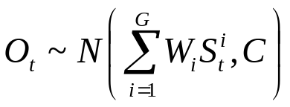
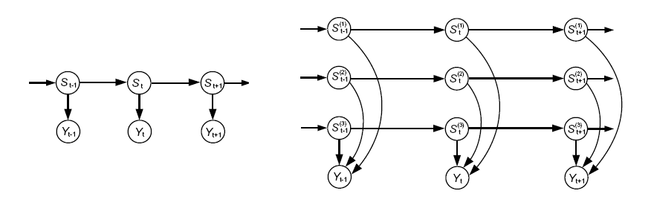
Factorial HMMs
Enable standard HMMs with distributed state representation.
Generalize the state represented by a collection of state variables S_{t} = S_{t}⁽¹⁾, ... , S_{t}^{(g)}, ... ,S_{t}^{(G)}. The state transition probabilities are specified by G distinct N×N transition matrices (under constrains).
The observation, O_{t} , is generated from a normal distribution with mean given by the weighted combination of the states of the underlying Markov Models:
The complexity is O(N²TG) for each iteration of training algorithm.
O_{t-1}
O_{t}
O_{t+1}
O_{t-1}
O_{t}
O_{t+1}
Notes:
For example, to represent 16 bits of information about the history of a time sequence, an standard HMM would need 2¹⁶ distinct hidden states. With a distributed state representation, like Factorial HMM, only 16 hidden states are needed to achieve the same task.
With the constrain that each state variable evolves according to its own dynamic. Namely, there are no transition between two states which are belongs to different state variables. Therefore, the state transition probabilities are specified by G distinct N×N transition matrix.
Assume real-valued output, the sequence of observable output vectors is generated from a normal distribution with mean given by the weighted combination of the states off the underlying Markov models:
O_{t} ~ N (Sum(W_{i}S_{i}^{t}), C)
Where, C is a common covariance matrix. The M -valued states s_{i} are represented as discrete column vectors with a 1 in one position and 0 everywhere else; the mean of the observable is therefore a combination of columns from each of the W_{i} matrices.
The complexity for EM algorithm is O(N²TG) per iteration. with mean field approximation and monte carlo gibbs sampling.

Slide 15
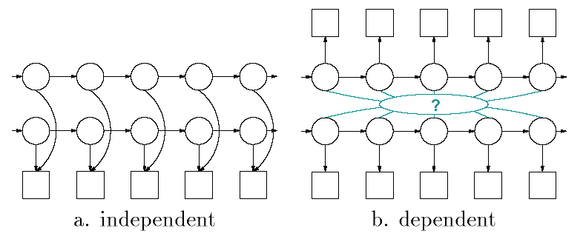
Coupled HMMs
Two basic kind of coupling strategies to extend the HMM framework.
The source separation problem: two independent processes are coupled at the output, super-imposing their output in a single signal as shown in figure a, which is exactly as FHMM.
The sensor fusion problem: the processes are dependent and interact by influencing each other’s states as shown in figure b, which is called coupled HMMs.
The complexity is O( (CN)² T) for each iteration EM training algorithm.
Notes:
Used to fuse multiple channels media data.
There are two basic kinds of couplings obtainable by extending the HMM framework. The weakest is when two independent processes are nominally coupled at the output, superimposing their output in a single signal as shown in figure a. This is generally known as the source separation problem: Signals with zero mutual information are overlaid in a signle channel. E.e., unrelated voices at a cocktail party.
In true couplings, the processes are dependent and interact by influencing each other’s states as shown in figure b. This is generally known as the sensor fusion problem. Namely, multiple channels carry complementary information about the different components of a system, e.g., acoustical signals from speech and visual features from lip-tracking.
We will take a look at the applications of the coupled HMMs later on
The complexity for CHMM is O(TN^{2c}), using naïve (Cartesian product), exact (state clustering), and stochastic (Monte Carlo) methods applied to the same inference problem. Where C is the number of channels. Brand introduce a deterministic approximation , with time complexity O(T(CN)²), for maximum a posterior (MAP) state estimation which enables fast classification and parameter estimation via EM.

Slide 16
Outline
Introduction
Hidden Markov Models
Extensions of Hidden Markov Models
HMMs in Unimodal Applications
HMMs in Multimodal Applications
Conclusions and Future Research Directions
Bibliography
Notes:
The unimodal data mentioned here refers to a homogenous data collected by a single sensor, such as audio, video, image, text, seismic, and etc.

Slide 17

Audio: Speech Recognition
isolated speech recognition
  A single HMM is constructed for each word w within a predefined vocabulary
  Given an acoustic sequence X₁^{T}={x₁, x₂, ... , x_{T},}, one can compute P(X₁^{T} | w) for each word w within the vocabulary
  When an a priori distribution P(w) on the words is also given, the most likely word w* given the acoustic sequence can be obtained by picking the model which maximizes both the acoustic probability and the prior
  The computational complexity for recognition is the number of words times the computation of the acoustic probability for a word.
connected speech recognition
  Map from an acoustic sequence to a sequence of words
  Need to build a language model to characterize the structural dependencies in sequences of symbols.
Notes:
Because speech recognition has been the most common applications of HMMs, we will first discuss it here.
The basic speech recognition problem can be stated as follows:
given a sequence of acoustic descriptors, find the sequence of words intended by the speaker who pronounced
those words. ( The acoustic descriptors are obtained by pre-processing the speech signal, e.g., spectral
information represented by a vector of between approximately 10 and 40 numbers, obtained at a rate of
around 10 millisecond per time step)
We will discuss two types of speech recognition.

Slide 18
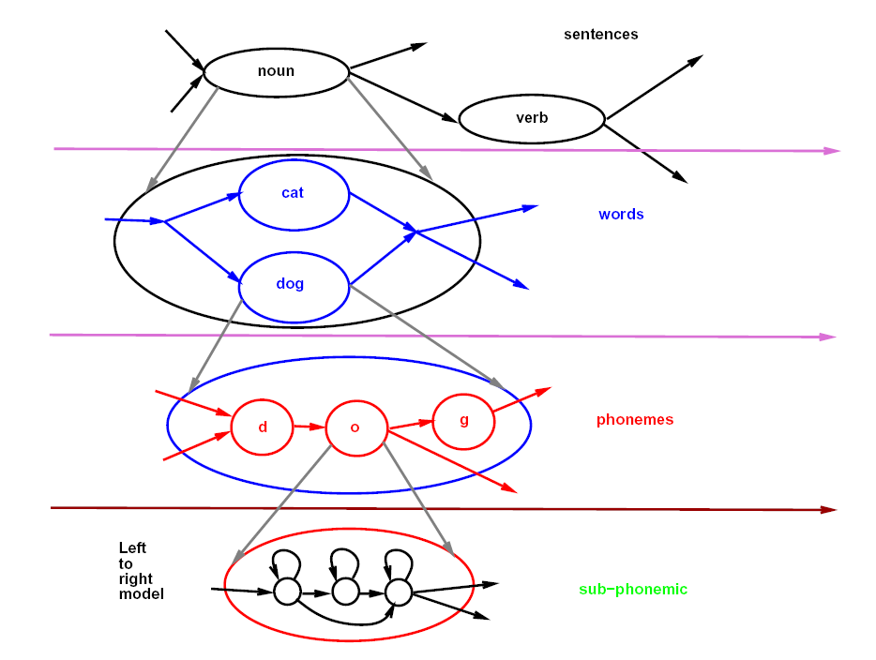
Audio: Speech Recognition
Build a language model for speech recognition using a hierarchical HMM.
Each level can be represented by a different type of HMM. Arcs represent transitions be-tween HMM states at a certain level (or groups of states at a lower level). Low-level models (e.g. phoneme models) are shared in many places in the overall HMM.
Notes:
An example of the topology of a part of an HMM for speech recognition is shown in the figure.

Slide 19
Video: Event Detection
HMMs and their extensions have been widely used in the activity detection and event detection.
Rare event detection in video usually has little training data.
Gong and Xiang proposed a Dynamically Multi-Linked Hidden Markov Model (DML-HMM), which is similar to the coupled HMMs to detect and classify an aircraft cargo unloading activity.
Zhang et al introduced an semi-supervised adapted HMMs for rare event detection, and claimed that this methods is better compared with those methods without using HMMs.
Chan, et al. proposed a semantic primitives with standard HMM for rare events detection in aerial video sequence, which conquers the problem of shortage of training data based on some prior knowledge about the events of interest.
Notes:
Recognizing activities or events taking place in a video stream is a major task in many applications, such as video surveillance system. Because video sequences are also sequential data, HMMs and their …..
In video surveillance, rare events detection received particular attention for security purpose. And rare event ….
So, this is a big challenge for hidden Markov models. There are couple of approaches based on HMMs were proposed to conquer this problem, namely detection of rare events
The basic idea of rare or unusual event detection is define a model based on the prior knowledge.

Slide 20
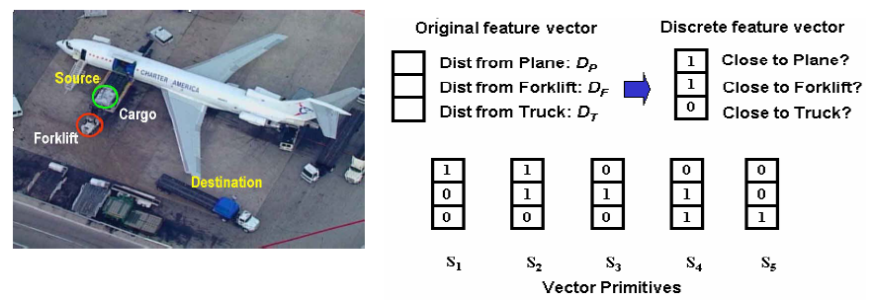
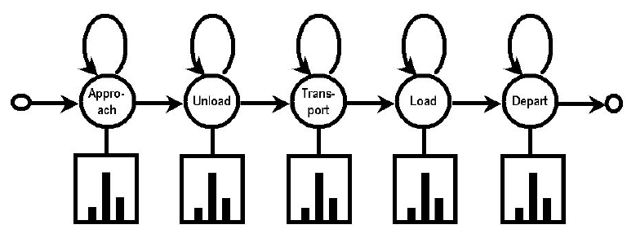
Video: Event Detection
Figure: Semantic primitives based HMMs for rare event detection (by Chan, et al)
Notes:
This event involves two moving objects, the forklift and the cargo container. They are tracked independently. The beginning and end of the cargo track is labeled as the Source and Destination respectively. The goal of event detection here is to find video subsequences in which cargo is moved from one location to another, while ignoring segments showing various other object movements.
Events are observed as a sequence of binarized distance relations among the objects participating in the event. This avoids directly modeling the temporal trajectories of continuous observations, which is difficult when training data is scarce.
The primary advantage is that very little training data is required, so that rare events can be recognized despite
significant variation in appearance and dynamics. A secondary advantage is that event models can be created
by users, using intuitive, human-level semantic primitives
This figure shows an HMM composed of 5 states that model a complete unload and load cycle

Slide 21

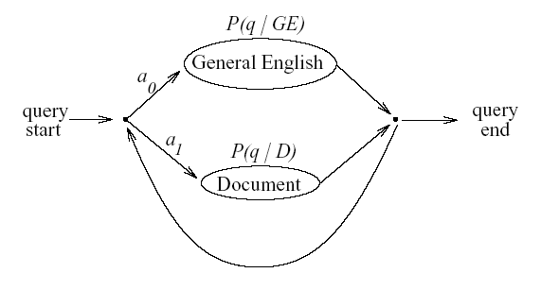

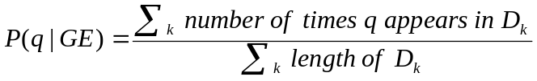

Text: Information Retrieval
The information retrieval can be model as the following probability model:
  Given a user-generated query Q and a set of documents D, rank the documents based on the probability that D is relevant, i.e., P(D is Relevant|Q).
Miller, et al. demonstrates that the HMM-based method outperforms the standard information retrieval method on test data collection.
A simple but powerful HMM is shown, with only two states, labeled as “GE” and “Document”
Train the output distribution :
Notes:
The TREC-6 collection comprises 556,077 documents from a variety of news and governmental agencies [20]. The TREC-7 collection is a subset of the TREC-6 collection containing 528,155 documents [22]
Based on baye’s rule, we have the formula, like this. P(Q) is a constant value for all document. And assume P(D is R) is the same for all document. We need only to evaluate P(Q|D is R).
“Document” represents choosing a word directly from the document, “General English” represents choosing a word that is unrelated to the document but that occurs commonly in natural language queries.
the output distribution for the "Document" state, P(q|D), is set to be the sample distribution on words appearing in that document
For state labeled as "General English", the sample distribution of the entire document corpus is used
Also a₀ and a₁ get trained using EM algorithm.

Slide 22
Text: Information Retrieval
Text is still the main media for information retrieval and data mining. Nevertheless, multimedia information retrieval and multimedia data mining have attracted increased attention
Content-based image and video analysis and retrieval algorithms have been the mainstream for multimedia data processing, which mainly based on color, shape, texture, or spatial similarity measurement for image retrieval and key-frame analysis for video retrieval
Using HMMs to study data mining with text, video and audio will be another interesting research topic.
Notes:
Given a set of image + caption pairs, Ghoshal, they construct, for each image, an HMM with as many states as the number of words in its caption.

Slide 23
Outline
Introduction
Hidden Markov Models
Extensions of Hidden Markov Models
HMMs in Unimodal Applications
HMMs in Multimodal Applications
Conclusions and Future Research Directions
Bibliography
Notes:
Here multimodal data fusion means fuse or integrate data from multiple sensors, e.g., data from mic, which is audio, data from camera, which is video, and data from other sources, like text, seismic data, etc.

Slide 24
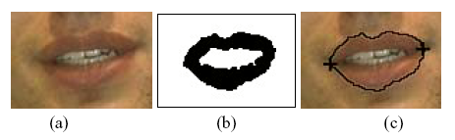
Bimodal Data Fusion: Audio-Visual Automatic Speech Recognition (ASR)
This research is motivated by the work of McGurk and MacDonald who showed that human beings are able to better distinguish spoken sounds when both audio and video are available..
A typical audio-visual ASR system makes use of two modalities, namely audio and visual, to improve the performance of ASR systems
There are two problems needs to be solved in order to implement an audio-visual ASR system
  A real time algorithm is needed to extract the lip information, namely to obtain visual features
  An algorithm or a model is needed to integrate the audio and visual information
Notes:
This research is motivated by the work of McGurk and MacDonald who showed that human beings are able to better distinguish spoken sounds when both audio and video are available.
To solve this problem, we can starts with the detection of the speaker's face in the video sequence. Then, the lower half of the detected face is a natural choice for the initial estimate of the mouth region as shown in a. Next, the mouth region is segmented out via some computer vision techniques, e.g., linear discriminant analysis (LDA) as shown in b. and finally the lip contour and position of the mouth corners are detected as shown in C

Slide 25
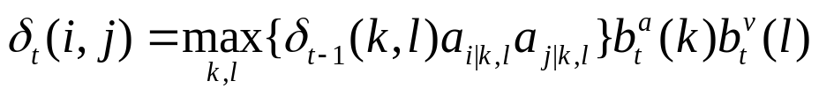
Bimodal Fusion: Audio-Visual ASR
Because of its inherent bimodal characteristic, coupled hidden Markov model (CHMM) is a widely chosen model for integrating the audio and visual modalities.
acoustic channel
The colored boxes are output and the circles are states.
The inference of the coupled HMM uses a generalized Viterbi algorithm. The recur-sive step of the generalized Viterbi algorithm is as follow. (all other formulas are ignored).
visual channel
t = 1
t = 2
t = 3
t = 4
t = T
Notes:
INTEGRATION STRATEGY?
A CHMM can be seen as a collection of HMMs, one for each data stream.
There are two state variables in the graph. The state of the system at certain time slice is jointly determined by the states of these two multinomial variables. More importantly, the state of each state variable is dependent on both of its two parents in the previous time slice. This configuration essentially permits unsynchronized progression of the two chains.
Note that the Markov property is not jettisoned by introducing the additional state variable and the directed links.

Slide 26
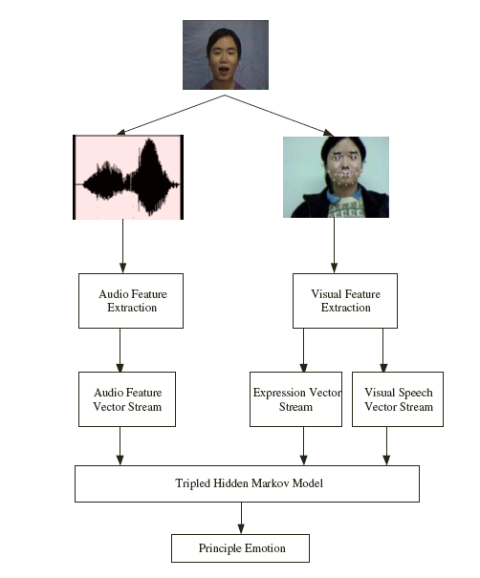
Multimodal Data Fusion:
Emotion Recognition
Recently, emotion recognition based on the integration of multi-modalities has received much more attention.
Traditional emotion recognition approaches are focused on extracting emotions from visual or audio information separately. Song, et al proposed a tripled HMMs, which integrate all these feature data, for emotion recognition.
The facial feature points are divided into two groups: visual speech part and expression one. Therefore, three HMMs are used to represent audio, visual and expression features, respectively.
The recursive procedure for training tripled HMMS is:
Notes:
Emotion recognition is one of the latest research topics in intelligent human-computer interaction and it is becoming more and more important in the intelligent communication between human and computer
In this application, it is pretty much similar to the bimodal data fusion.

Slide 27
Outline
Introduction
Hidden Markov Models
Extensions of Hidden Markov Models
HMMs in Unimodal Applications
HMMs in Multimodal Applications
Conclusions and Future Research Directions
Bibliography

Slide 28
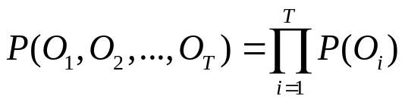
Limitations of HMMs
A major limitation is the assumption that successive observations are independent. and hence the probability of a sequence of observations P(O₁, O₂, ... , O_{T}) can be simplified as a product of the probabilities of individual observation
Another limitation is the assumption that the distributions of individual observation parameters can be well represented as a mixture of Gaussian densities, which is also a strong restriction for most applications.
The Markov assumption itself, that is, the probability of being in a given state at time t only depends on the state at time t-1, is not suitable for real applications where dependencies often extend through several or even more states.
Notes:
Although many research communities have been benefit from the use of the HMM technology, there are some inherent limitation in the technology itself.
A major limitation is the assumption that successive observations are independent, and hence the probability of a sequence of observations P(O₁, O₂, ... , O_{T}) can be simplified as a product of the probabilities of individual observation, that is
The second assumption has something to do with the model parameters estimation.

Slide 29
Future Research Directions
New Framework Design
  To enhance HMMs for integrating multiple modalities.
Efficient Inference and Learning Algorithms
  Required for some complicated extensions of HMMs for real time performance.
Hidden States Determination
  Systematically methods needed based on observations and domain knowledge.
Effective Features Extraction
  Find more effective features from all modalities for better fitting multimodal data into the architecture of HMMs.
Individual Modality Performance Improvement
  More efforts could be produced to improve some modalities where remarkable progress is still possible to be accomplished, like data from vision, taste, smell, etc.
Notes:
New Framework/Architecture/Structure/Topology design.
Could use some transformation for inference and learning algorithms.

Slide 30
Outline
Introduction
Hidden Markov Models
Extensions of Hidden Markov Models
HMMs in Unimodal Applications
HMMs in Multimodal Applications
Conclusions and Future Research Directions
Bibliography

Slide 31
Bibliography
L. R. Rabiner, A tutorial on hidden Markov models and selected applications in speech recognition. Proceedings of the IEEE 1989
M. Song, J. Bu, C. Chen and N. Li, Audio-Visual based Emotion Recognition - A New Approach. Proceedings of Int. Conf. on Computer Vision and Pattern Recognition (CVPR'04), June 2004
M. Chan, A. Hoogs, J. Schmiederer, M. Pertersen. Detecting Rare Events in Video Using Semantic Primitives with HMM. Proceedings of the 17th Int. Conf. on Pattern Recognition (ICPR'04) August 2004
J A. Bilmes, A Gentle Tutorial of the EM Algorithm and its Application to Parameter Estimation for Gaussian Mixture and Hidden Markov Models, Technical Report U. C. Berkeley, April 1998
D. R. H. Miller, T. Leek and R. M. Schwartz, A Hidden Markov Model Information Retrieval System, ACM SIGIR 1999
And others …

Slide 32
Thank you!

